Slide 1
What is Big Data?

Slide 2






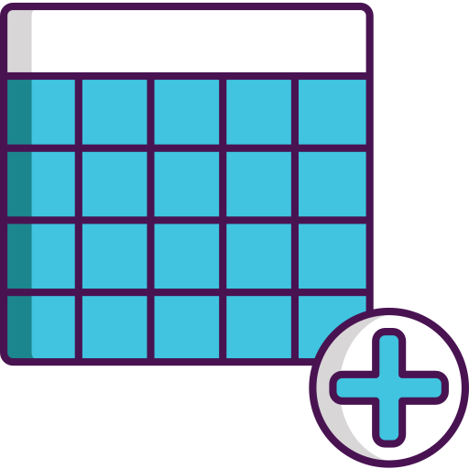


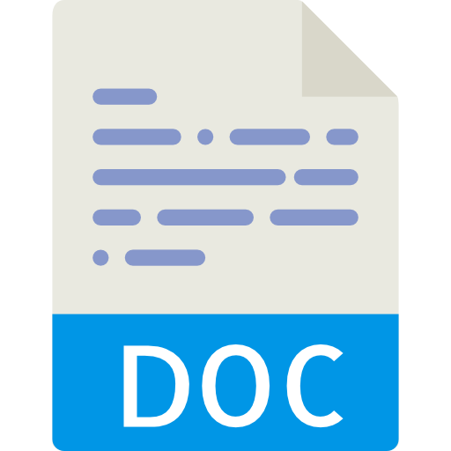


What is Data?
Data is the individual unit of information that is defined as figures or facts and stored for later processing
Data Types:
Structured Data
Semi-structured Data
Unstructured Data

Slide 3







What is Big Data?
Big Data is a collection of extremely large datasets that may be analyzed computationally to reveal patterns, trends, and associations, especially relating to human behavior and interactions.
Similar Examples:
It captures voices of the flight crew, recordings of microphones and earphones, and the performance information of the aircraft.
Power Grid
Data
Transport Data
Black Box Data
Social media such as Facebook and Twitter hold information and the views posted by millions of people across the globe.
Stock Exchange
Data
Search Engine
Data
Social Media Data

Slide 4
Categorizing Data as Big Data
5 Vs of Big Data

Slide 5
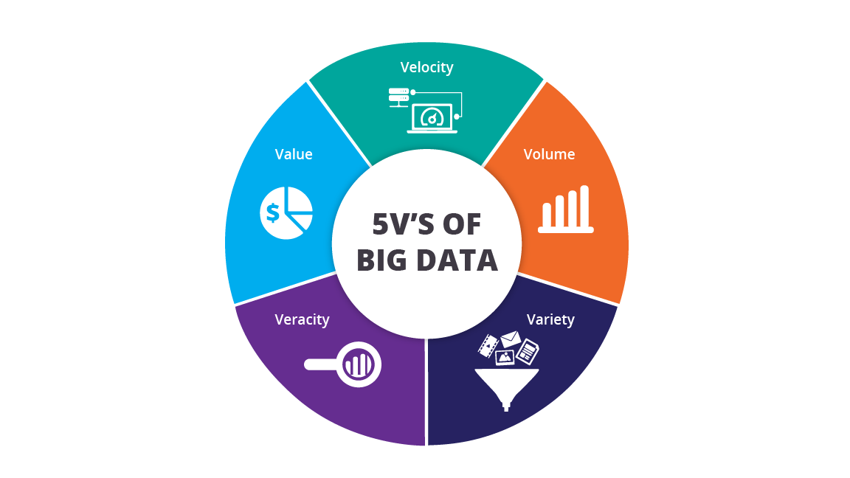
5 Vs of Big Data
5 Vs
of
Big Data
To make sense of the huge amount of data, it is often broken down based on the five Vs: Velocity, Volume, Value, Variety, and Veracity

Slide 6
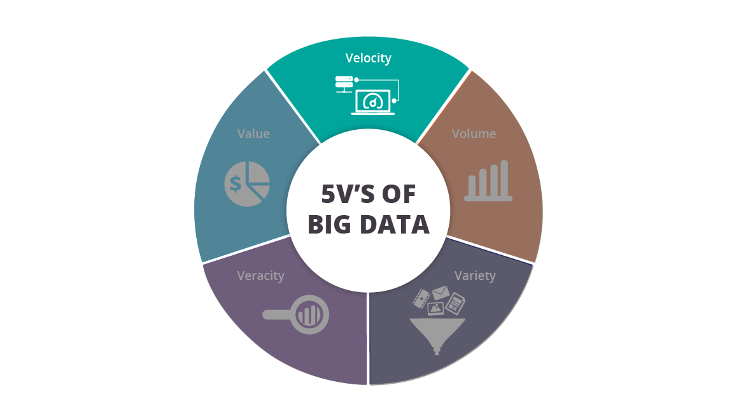
5 Vs of Big Data: Velocity
Velocity refers to the high speed at which data flows in from multiple sources such as machines, networks, social media, mobile phones, etc.
There is a massive and continuous flow of data
Example: On Google, more than 3.5 billion searches are made per day
5 Vs
of
Big Data

Slide 7
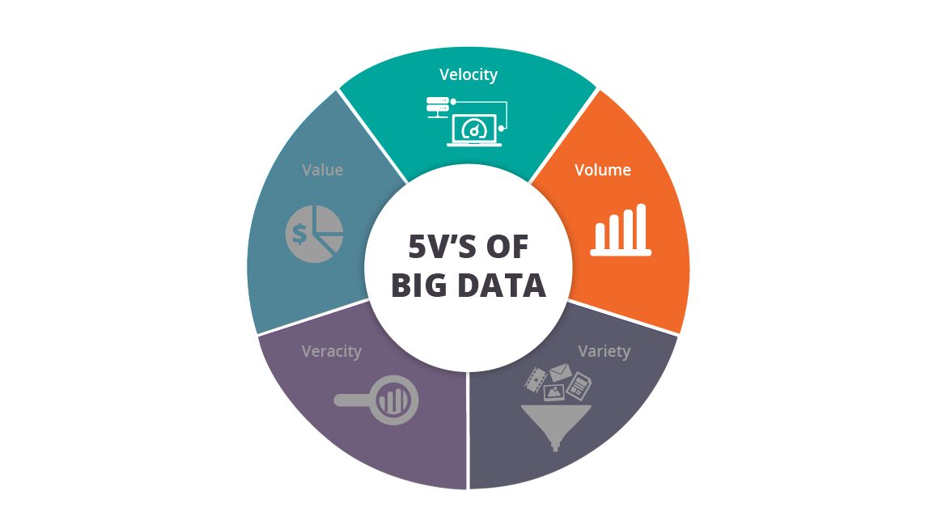
5 Vs of Big Data: Volume
Volume means the huge amount of data!
To determine volume, the size of the data plays a crucial role
When dealing with Big Data, it is necessary to consider the ‘volume’ of it
Example: In the year 2016, the estimated global mobile traffic was 6.2 exabytes (6.2 billion GB) per month
5 Vs
of
Big Data

Slide 8
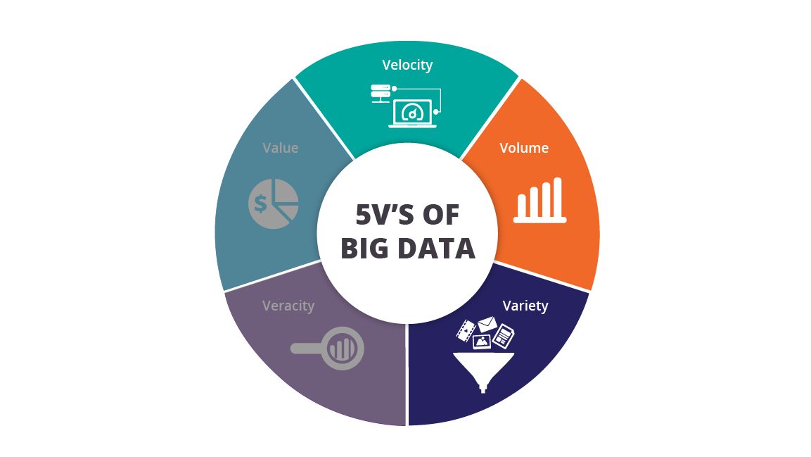
5 Vs of Big Data: Variety
It refers to the nature of data, i.e., whether the data is structured, semi-structured, or unstructured
It also refers to the heterogeneous sources
Variety is basically the arrival of data from various new sources both inside and outside of an enterprise
5 Vs
of
Big Data

Slide 9
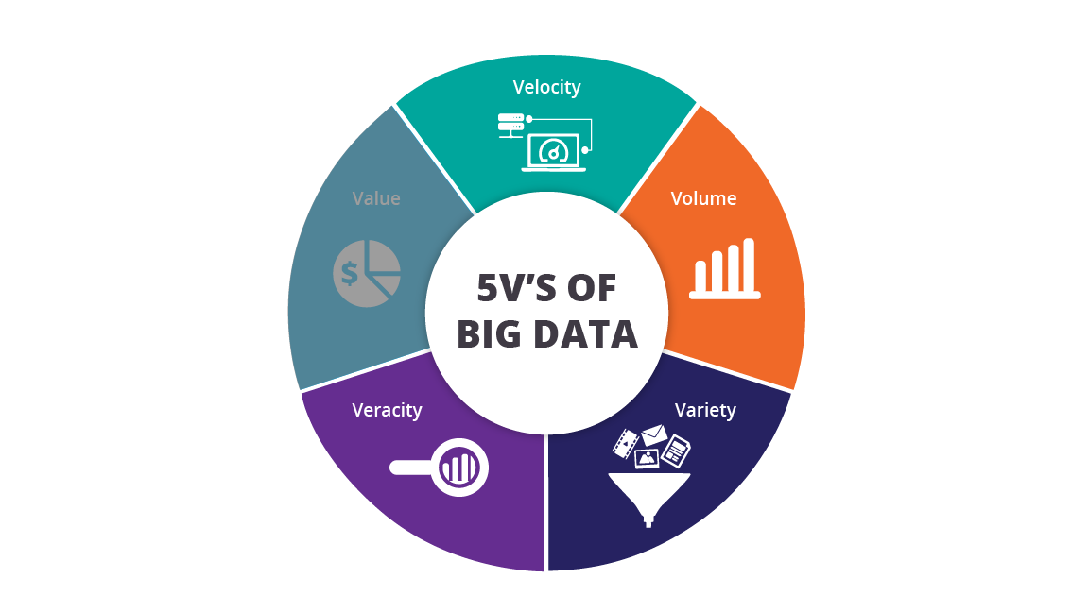
5 Vs of Big Data: Veracity
It refers to the inconsistencies and uncertainties in data
Data can sometimes get messy; hence, quality and accuracy of the data are difficult to control
Data in bulk can create confusion; whereas, less amount of data can convey half or incomplete information
5 Vs
of
Big Data

Slide 10
5 Vs of Big Data: Value
The bulk of data having no value is of no good to the company, unless we turn it into something useful
Data (just by itself) is of no use or importance, but it needs to be converted into something valuable to extract information
Hence, we can state that ‘value’ is the most important ‘V’ of all the 5Vs
5 Vs
of
Big Data

Slide 11


Problems with Big Data
The good news is that Big Data is here!
The bad news is that we are struggling to store and analyze it
Problem 1: Hardware Failure
Problem 2: Combining Data
Although the storage capacities of hard drives have increased massively over the years, access speeds—the rate at which data can be read from the drives—have not kept up to the mark!
Most analyses require to combine data in some way; data read from one disk may need to be combined with the data from any of the other 99 disks—a challenging task for distributed systems!

Slide 12
Problems with Big Data
Solution for Hardware Failure
Solution for Combining Data
While we start using many pieces of hardware, the chance for one to fail is fairly high, and this might result in data loss.
A common way of avoiding data loss is through replication: creating multiple copies of the data so that, in the event of failure, there is another copy available.
This is what Hadoop does. Hadoop’s file system, Hadoop Distributed File System (HDFS), creates multiple copies of the data
MapReduce provides a programming model that abstracts the problem from the disk, reads and writes, and transforms it into a computation—map and reduce— over sets of keys and values
MapReduce has a built-in reliability, an interface where the ‘mixing’ of map and reduce occurs

Slide 13
What is Hadoop?

Slide 14

What is Hadoop?
Apache Hadoop is a platform used for storing Big Data across a spectrum of devices
This is done to help us process Big Data in parallel
It is made up of a distributed file system called HDFS and a computation layer called MapReduce, which is a processing paradigm
Hadoop is an open-source, batch data processing system for dealing with enormous amounts of data
Goals/Requirements
Abstracting and facilitating the storage and processing of large and/or rapidly growing datasets
Structured and non-structured data
Simple programming models

Slide 15
History of Hadoop
Doug Cutting joins Yahoo
NFDS and MapReduce are pulled out of Nutch to be clubbed under a new project, Hadoop
Many sub-projects, namely, HBase and Hive, are established
Hortonworks is stablished
YARN is created
Apache releases new Hadoop version, Hadoop3.x
Apache Nutch is created by Doug Cutting and Mike Cafarella
2017
2004
2008
2013
2002
2006
2011
Nutch Distributed File System (NDFS) is established
Nutch gets divided and Hadoop is born
Yahoo releases Hadoop as open-source project to ASF
Hadoop-based startup, Cloudera is incorporated
Greenplum releases Hadoop distribution
2019
Apache releases Hadoop 3.2

Slide 16



Use Cases of Hadoop
Using “Know Me Program”, complete information of travelers was retrieved, such as, when they are planning to travel, where they are planning to travel, etc., leading to the increase in sales and hence achieving a hike in revenue.
Using Hadoop, Uber was able to achieve 100+ petabytes of data within a minute. Which helped Uber in increasing their network in several countries and hence provide service with zero or negligible latency.
Amazon Web Services uses the open-source Apache Hadoop distributed computing technology to make it easier to access large amounts of computing power to run data-intensive tasks.

Slide 17
Why Hadoop is a solution?

Slide 18
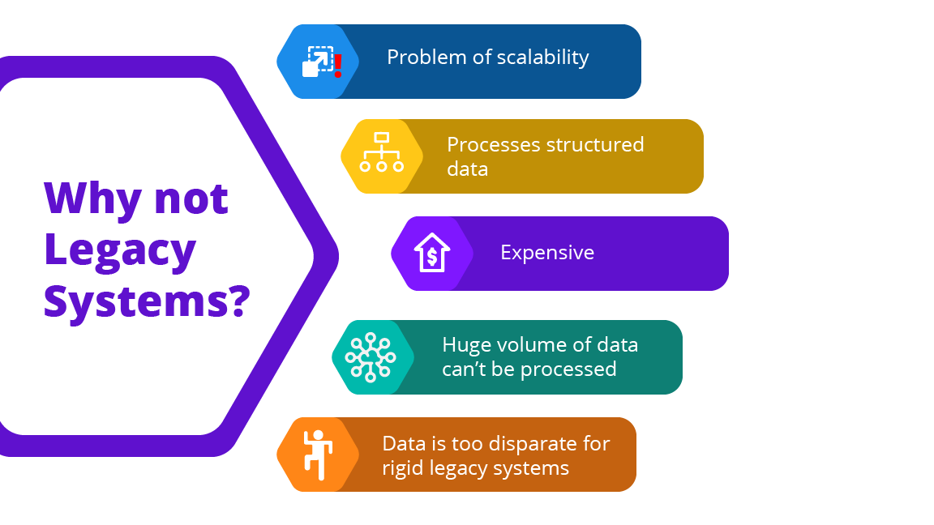
Why not Legacy Systems?
Process only structured data
Cannot process huge volumes of data
Cannot process heterogeneous data

Slide 19
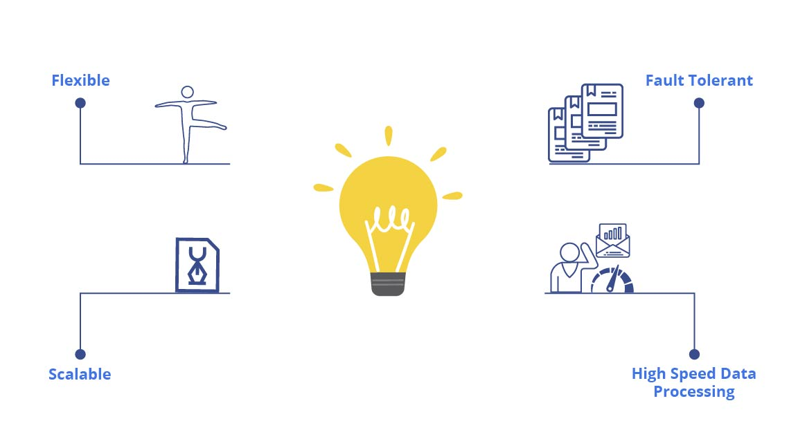
Why Hadoop?

Slide 20

Why Hadoop?
Flexible
A major challenge for any company or organization is the handling of structured and unstructured data available in Big Data
Hadoop is very flexible and handles structured and unstructured data efficiently
Hadoop can also handle encoded data and process it according to company needs

Slide 21

Why Hadoop?
Scalable
Additional nodes can be added when the maximum size of the storage nodes is reached, making the Hadoop framework easily scalable across the spectrum
The nodes are independent of each other, so adding a new node to the cluster will not be difficult

Slide 22

Why Hadoop?
Fault Tolerant
Whenever data is stored in HDFS, it gets replicated three times at multiple locations in the cluster
So, even if one or two of the systems collapse, the file will still be available on the backup system so that it can be easily retrieved
Hadoop is bulletproof in terms of fault tolerance

Slide 23

Why Hadoop?
High Speed Data Processing
Hadoop works on the concept of parallel processing
It can perform batch processes 10 times faster than on a singlethreaded server or on the mainframe
Hadoop is a comparatively cheaper and cost-effective way of handling Big Data than the other frameworks
In the 2014, a team from Databricks used a 207-node Spark cluster to sort 100 TB of data in 1,406 seconds, i.e., 4.27 TB in 1 minute!

Slide 24

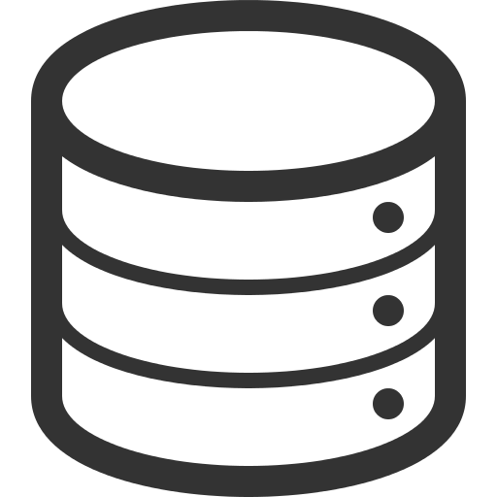




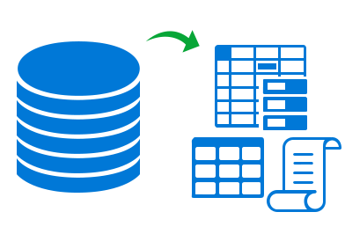
Hadoop vs RDBMS
Used for structured, semi-Structured, and unstructured data
Mainly used for structured data
PB
Used for large datasets (TBs and PBs)
Used for average sized data (GBs)
TB
Reads and writes data quickly
Only reads data quickly

Slide 25
Hadoop Ecosystem

Slide 26
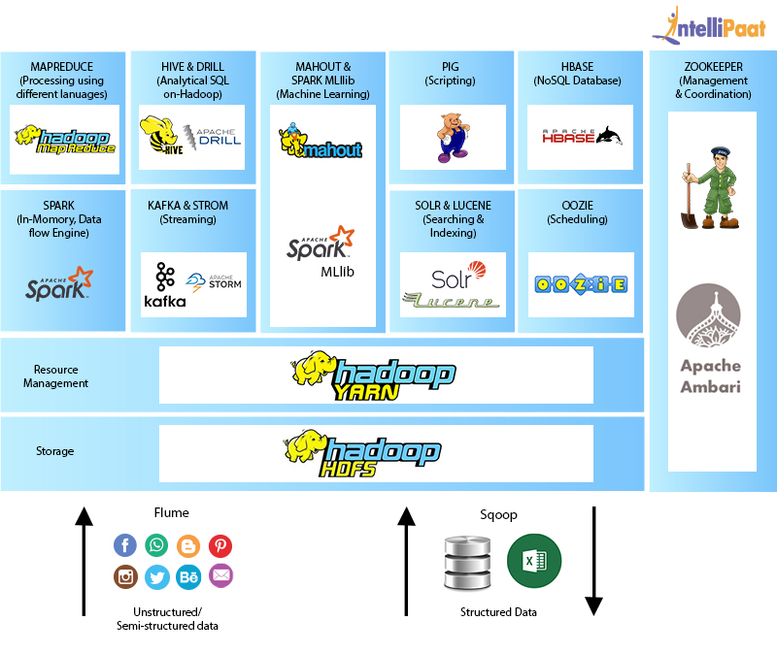
Hadoop Ecosystem
MapReduce
(Processing using different languages)
Hive & Drill
(Analytical SQL on Hadoop)
Mahout & Spark MLlib
(Machine Learning)
Pig
(Scripting)
HBase
(NoSQL database)
ZooKeeper
(Management & coordination)
Spark
(In-memory data flow engine)
Kafka & Strom
(Streaming)
Solr & Lucene
(Searching & indexing)
Oozie
(Scheduling)
Solr & Lucene
(Searching & indexing)
Resource Management
Storage
Flume
Sqoop
Unstructured/semi-structured data
Structured data

Slide 27

Core Components: HDFS
Hadoop Distributed File System (HDFS) is a storage system that runs on Java programming language, and it is used as the primary storage device in Hadoop applications
HDFS consists of two components, NameNode and DataNode
These are used to store large data across multiple nodes on the Hadoop cluster

Slide 28
Sales.csv[384MB]
Every Hadoop cluster has block size. The default block size = 128 MB.
Sales.csv file will be divided into 3 blocks.
By default, Hadoop has a replication factor = 3
The namenode stores metadata. The Namenode will have the following information
Sales.csv is divided into B1,B2,B3
B1→ DN1,DN2,DN3
B2 → DN3,DN4,DN5
B3 → DN2,DN4,DN5
Master
Active Namenode
Master
Standby Namenode
Slave-I
Datanode-I
Slave-II
Datanode-II
Slave-III
Datanode-III
Slave-IV
Datanode-IV
Slave-V
Datanode-V
B1
B1
B3
B1
B2
B2
B3
B2
B3

Slide 29
Master
Journal-1
edits
Master
Journal-2
edits
Master
Journal-3
edits
Master
Active Namenode
FSIMAGE
Master
Standby Namenode
FSIMAGE

Slide 30

Core Components: MapReduce
MapReduce acts as a core component in Hadoop Ecosystem as it facilitates the logic of processing
It is a software framework, which enables us in writing applications that process large datasets using distributed and parallel algorithms in a Hadoop environment
The parallel processing feature of MapReduce plays a crucial role in Hadoop ecosystem. It helps in performing Big Data analysis using multiple machines in the same cluster
Map function: It converts one set of data into another, where individual elements are broken down into tuples (key/value pairs)
Reduce function: It takes data from the Map function as an input, and it aggregates and summarizes the results produced by the Map function

Slide 31


Core Components: YARN
YARN supports a variety of processing engines and applications
It distributes its duties across multiple components
Dynamically, it allocates pools of resources to other applications on the go
YARN supports multiple scheduling methods based on the queue format for submitting the processing jobs
The default scheduler works on FIFO

Slide 32



Hadoop 2.x vs Hadoop 3.x
Hadoop 2.x
Hadoop 3.x
200%
Consumes 200% of storage in HDFS
Consumes just 50% of storage in HDFS
Scalability is limited (Up to 10,000 nodes in a cluster)
Scalability has improved (Over 10,000 nodes in a cluster)
Supports DFS, FTP, and Amazon S3 file system
All features plus Microsoft Azure Data Lake File system are supported
Uses HDFS balancer for data balancing
Uses intra-data node balancer for data balancing

Slide 33
What is HDFS?

Slide 34


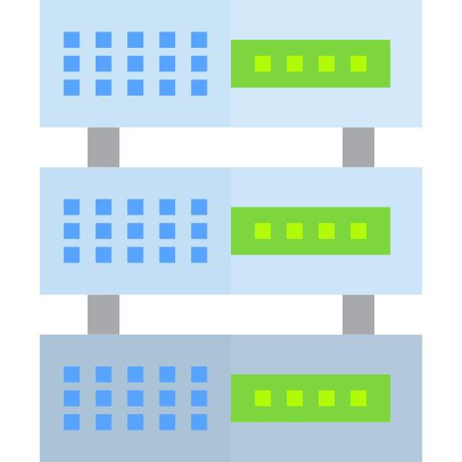
What is HDFS?
HDFS is a file system designed for storing very large files with streaming data access patterns, running on clusters of commodity hardware
‘Very large files,’ in this context, means the files that are of hundreds of gigabytes, terabytes, or petabytes in size.
TB
Streaming Data Access: Each analysis of the dataset involves a large portion of the dataset, so the time to read the whole dataset is more important than the latency in reading the first record.
Commodity Hardware: Hadoop is designed to run on clusters of commodity hardware, where the chance of node failure is high. HDFS is designed to carry on working without a noticeable interruption in the face of such a failure.

Slide 35

HDFS Design Factors
Factors involved in the design of HDFS:
High throughput
Hundreds/thousands of nodes
Handling large datasets (TBs and PBs)
Portability across heterogeneous hardware/software

Slide 36




Approach to Meet HDFS Design Goals
How was the design of HDFS altered to meet its design goals?
Simplified Coherency Model: Write once read many times
Move Computation Close to Data: Not moving data around and hence improving efficiency
Data Replication: Helps in handling hardware failure

Slide 37
HDFS: Why have another file system?

Slide 38

Need for HDFS
HDFS divides Big Data into several chunks and processes each chunk of data separately on separate machines
Since all the machines run on commodity hardware, it is very cheap
Centralized File System
Distributed File System
X 10
1 Server
4 I/O Channels (100 MB/s)
10 Servers
4 I/O Channels (100 MB/s)
Reads 1 TB data in 43 minutes
Reads 1 TB data in 4.3 minutes!

Slide 39

How did HDFS solve the problem of Big Data?
HDFS uses the MapReduce method for accessing data, which is very fast
HDFS follows the data coherency model, in which the data is synchronized across the server. It is very simple to implement and highly robust and scalable
HDFS is compatible with any kind of commodity hardware and operating system processors
As data is saved in multiple locations, HDFS is fault tolerant
HDFS
Big Data

Slide 40
HDFS Components

Slide 41
HDFS Components: Nodes
G
NameNode (Master)
An HDFS cluster has two types of nodes operating in a master−slave pattern
DataNode (Slave)

Slide 42
HDFS Components: NameNode
The NameNode manages the file system namespace and maintains the file system tree and the metadata for all files and directories in the tree
This information is stored persistently on the local disk in the form of two files: namespace image and edit log
The NameNode also knows the DataNodes on which all blocks for a given file are located. It doesn’t store block locations persistently, as this is retrieved from DataNodes whenever the requirement pops up
G
NameNode

Slide 43
HDFS Components: DataNode
DataNodes are responsible for storing the actual data in HDFS
They are the workhorses of the file system
It stores and retrieves blocks whenever required
It reports back to the NameNode periodically with the list of blocks it is storing
When a DataNode starts up, it notifies the NameNode, along with the list of blocks it is responsible for
The NameNode arranges the replication of blocks managed by the DataNode that is not available
DataNodes

Slide 44
HDFS Components: Secondary NameNode
Secondary NameNode doesn’t act as a ‘secondary’ NameNode
Its main role is to periodically merge the namespace image with the edit log to prevent the edit log from becoming too large
It runs on a separate physical machine as it requires plenty of CPU and memory for performing the merge
It keeps a copy of the namespace image that can be used when the NameNode fails
In case a NameNode fails, the Secondary NameNode will copy the NameNode’s metadata files to itself and will run as the new primary NameNode
Secondary NameNode

Slide 45
HDFS Components: Blocks
The smallest unit writable by a disk or ﬁle system
Everything a ﬁle system does is composed of operations done on blocks
Blocks are stored on DataNodes
Can the block size of HDFS be increased?
Default block size in HDFS: 128 MB
1
2
1
2
1
2
Blocks
5
Blocks
5
Blocks
5
3
4
3
4
3
4
DataNode 1
DataNode 2
DataNode 3

Slide 46



HDFS Components: Blocks
Data is stored in HDFS in several blocks, with a maximum size 128 MB
This is how it is:
Why is a Block in HDFS so large?
To minimize the cost of seeks
BLK_1
BLK_2
Abc.txt
200 Mb
Transferring large files made up of multiple blocks operates at the disk transfer rate
128 Mb
72 Mb

Slide 47
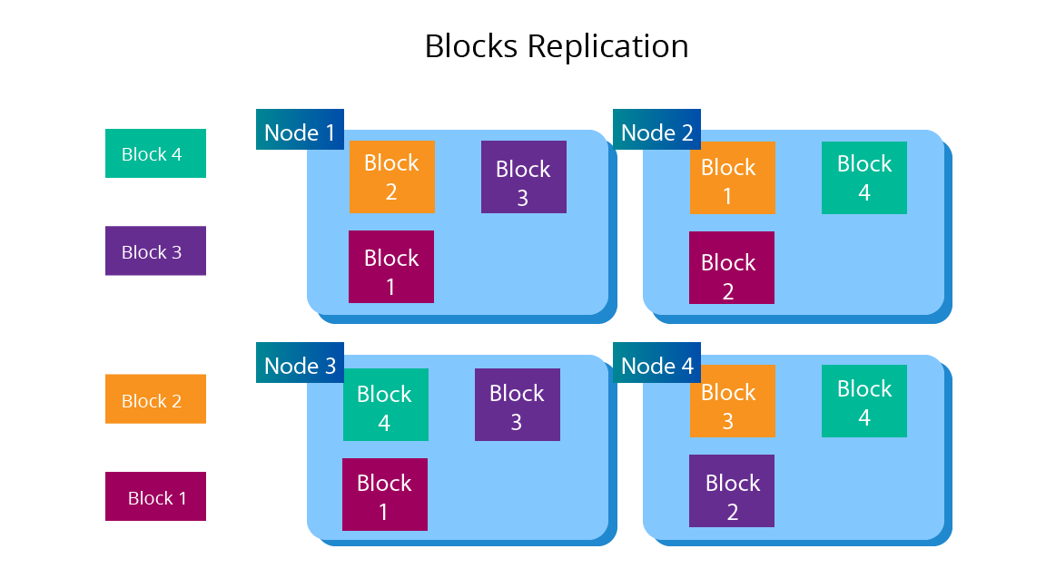
HDFS Components: Blocks
Block Replication
To avoid fault tolerance, blocks are replicated inside multiple DataNodes present in the cluster
To insure against corrupted blocks and disk and machine failure, each block is replicated to a small number of physically separated machines (typically three)
If a block is unavailable (due to loss of connection), a copy can be read from another location in a way that is transparent to the client

Slide 48


HDFS Components: Blocks
Block Caching
For frequently accessing files, blocks are explicitly cached in a DataNode’s memory
Hadoop frameworks take advantage of cached blocks by running tasks on the DataNode where a block is cached, for increased read performance
Cache
Block_1

Slide 49
HDFS Architecture

Slide 50
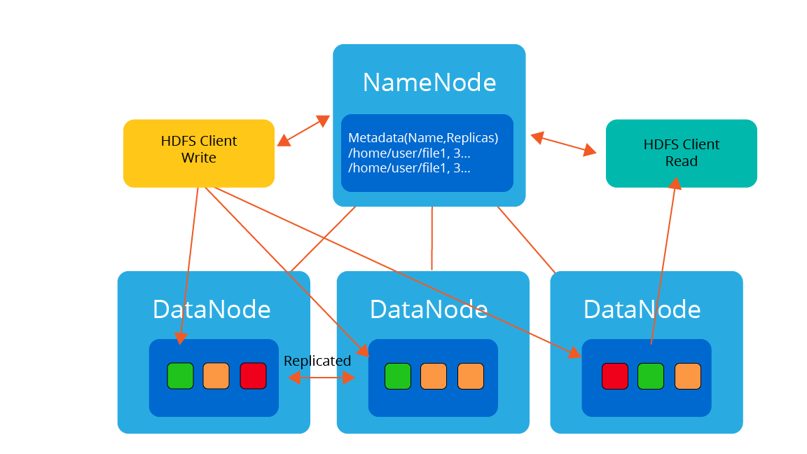
HDFS Architecture
Replicated

Slide 51
Writing Data in HDFS

Slide 52
How is data written in HDFS?
Client requests to create a file
Replicated

Slide 53
How is data written in HDFS?
NameNode is contacted once a block of data is accumulated
Replicated

Slide 54
How is data written in HDFS?
NameNode responds with a list of DataNodes
Replicated

Slide 55
How is data written in HDFS?
DataNode receives data from HDFS Client, and writes to local
Replicated

Slide 56
How is data written in HDFS?
DataNode forwards the file to a second DataNode for replication and then to a third
Replicated

Slide 57
How is data written in HDFS?
NameNode commits the file creation into persistent store
It receives heartbeat and block reports
Replicated

Slide 58
How is data written in HDFS?
Client gets the DataNode list from the NameNode
It reads from the replica closest to the render
Replicated

Slide 59
Reading Data in HDFS

Slide 60
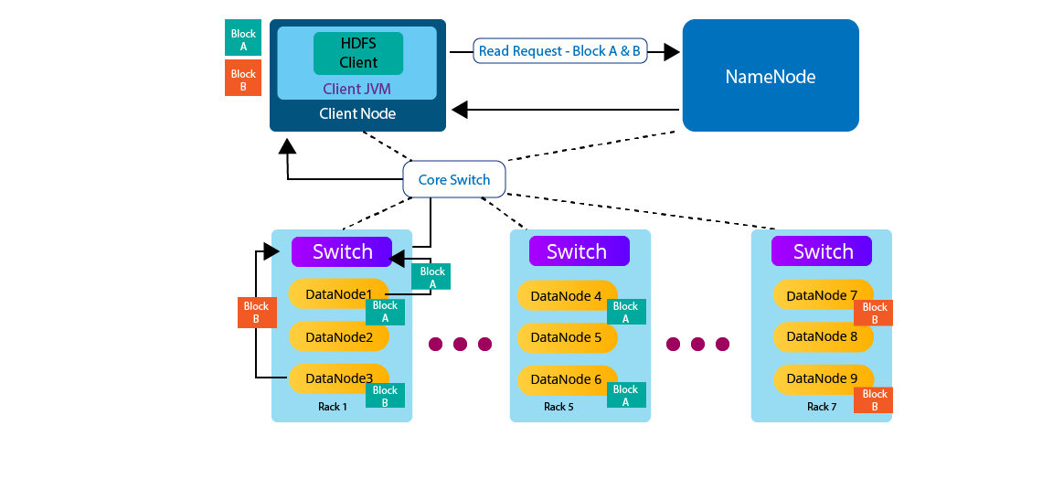
How is data read in HDFS?
1

Slide 61
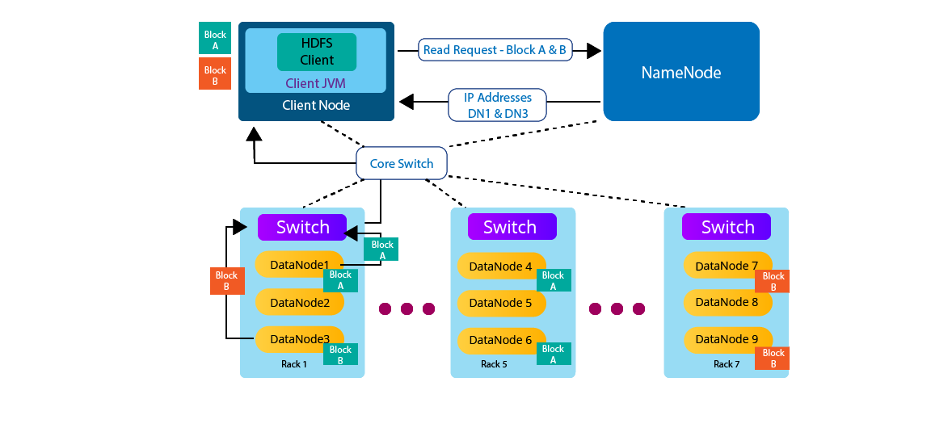
How is data read in HDFS?
1
2

Slide 62
How is data read in HDFS?
1
2
3
Core Switch will try to access DN1 and DN3

Slide 63

How is data read in HDFS?
1
2
3
Core Switch will try to access DN1 and DN3
4a
4b

Slide 64
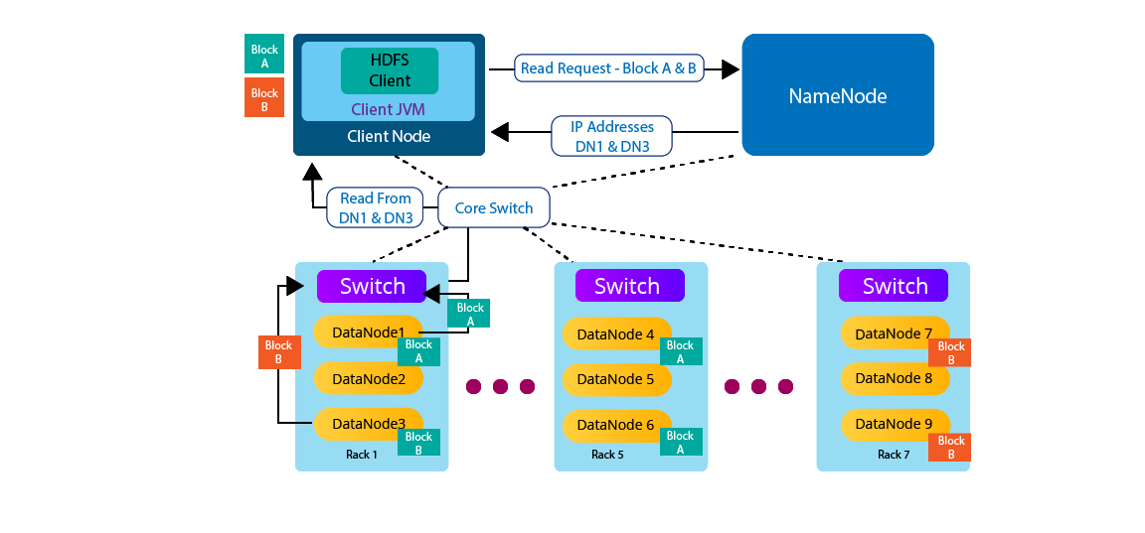
How is data read in HDFS?
1
2
3
Core Switch will try to access DN1 and DN3
5
4a
4b

Slide 65
HDFS Commands

Slide 66
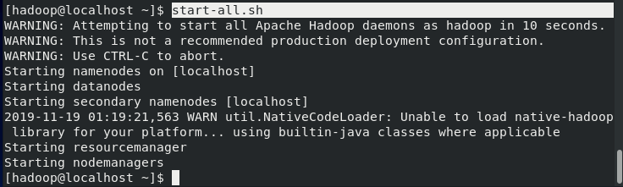
HDFS Commands: Starting Hadoop services
start-all.sh

Slide 67
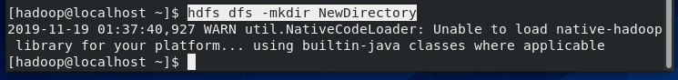
HDFS Commands: Creating a Directory
hdfs dfs -mkdir NewDirectory

Slide 68
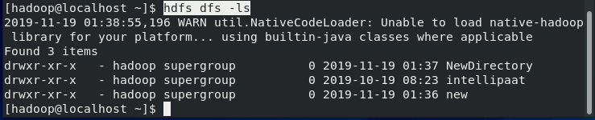
HDFS Commands: Displaying files in HDFS
hdfs dfs -ls

Slide 69
HDFS Commands: Creating a Local File
Now, let’s create a local file and copy it into HDFS:
Create a file with random data using Linux utility dd
Command:
dd if=/dev/urandom of=example.txt bs=64M count=16
This will create a 1 GB file named example.txt on our local system

Slide 70
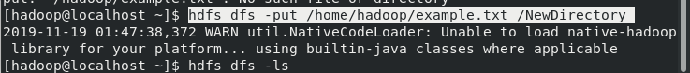
HDFS Commands: Copying a File to HDFS
hdfs dfs -put <local file path>example.txt /<HDFS Directory>

Slide 71
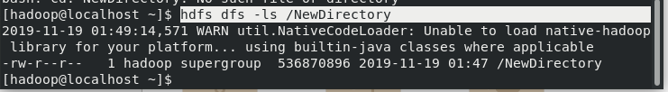
HDFS Commands: Displaying files in directory
hdfs dfs –ls /<HDFS directory>

Slide 72
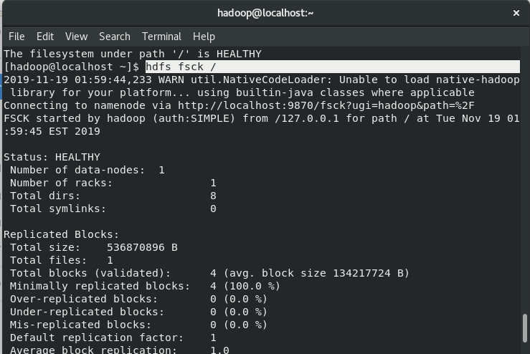
HDFS Commands: Checking the Health of HDFS
hdfs fsck /

Slide 73
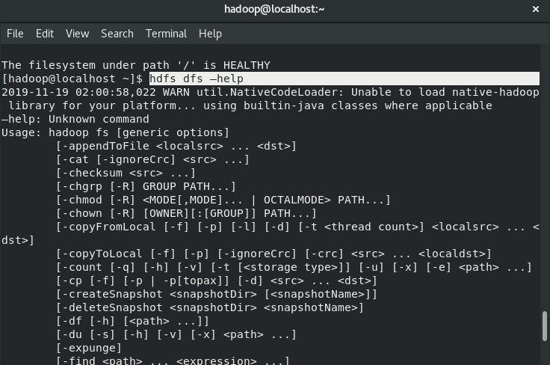
HDFS Commands: Listing All Commands
hdfs dfs -help

